Slide 1
A PRIMER ON INTERNET ANTI-SEMITISM & NEO-NAZI INCITEMENT
AMB. MARC GINSBERG
ERIC FEINBERG
National assembly of rabbis
Webinar
November 19, 2019
COPYWRITED © BY CSW

Slide 2
THE COALITION FOR A SAFER WEB
NON-PROFIT/NON-PARTISAN ADVOCACY ORGANIZATION
DEDICATED TO FORGING PUBLIC & PRIVATE TECHNOLOGY SOLUTIONS TO DE-PLATFORM ANTI-SEMITIC & RADICAL ISLAMIC INCITEMENT
CSW’S GOALS:
* NEW PRIVATE SECTOR SOCIAL MEDIA AUDIT BOARD
* TECHNOLOGY/SOFTWARE INNOVATION
* REGULATION/SANCTION OF “DEEP WEB” INTERNET COs
* STUDENT ANTI-EXTREMISM EDUCATION INITIATIVES

Slide 3
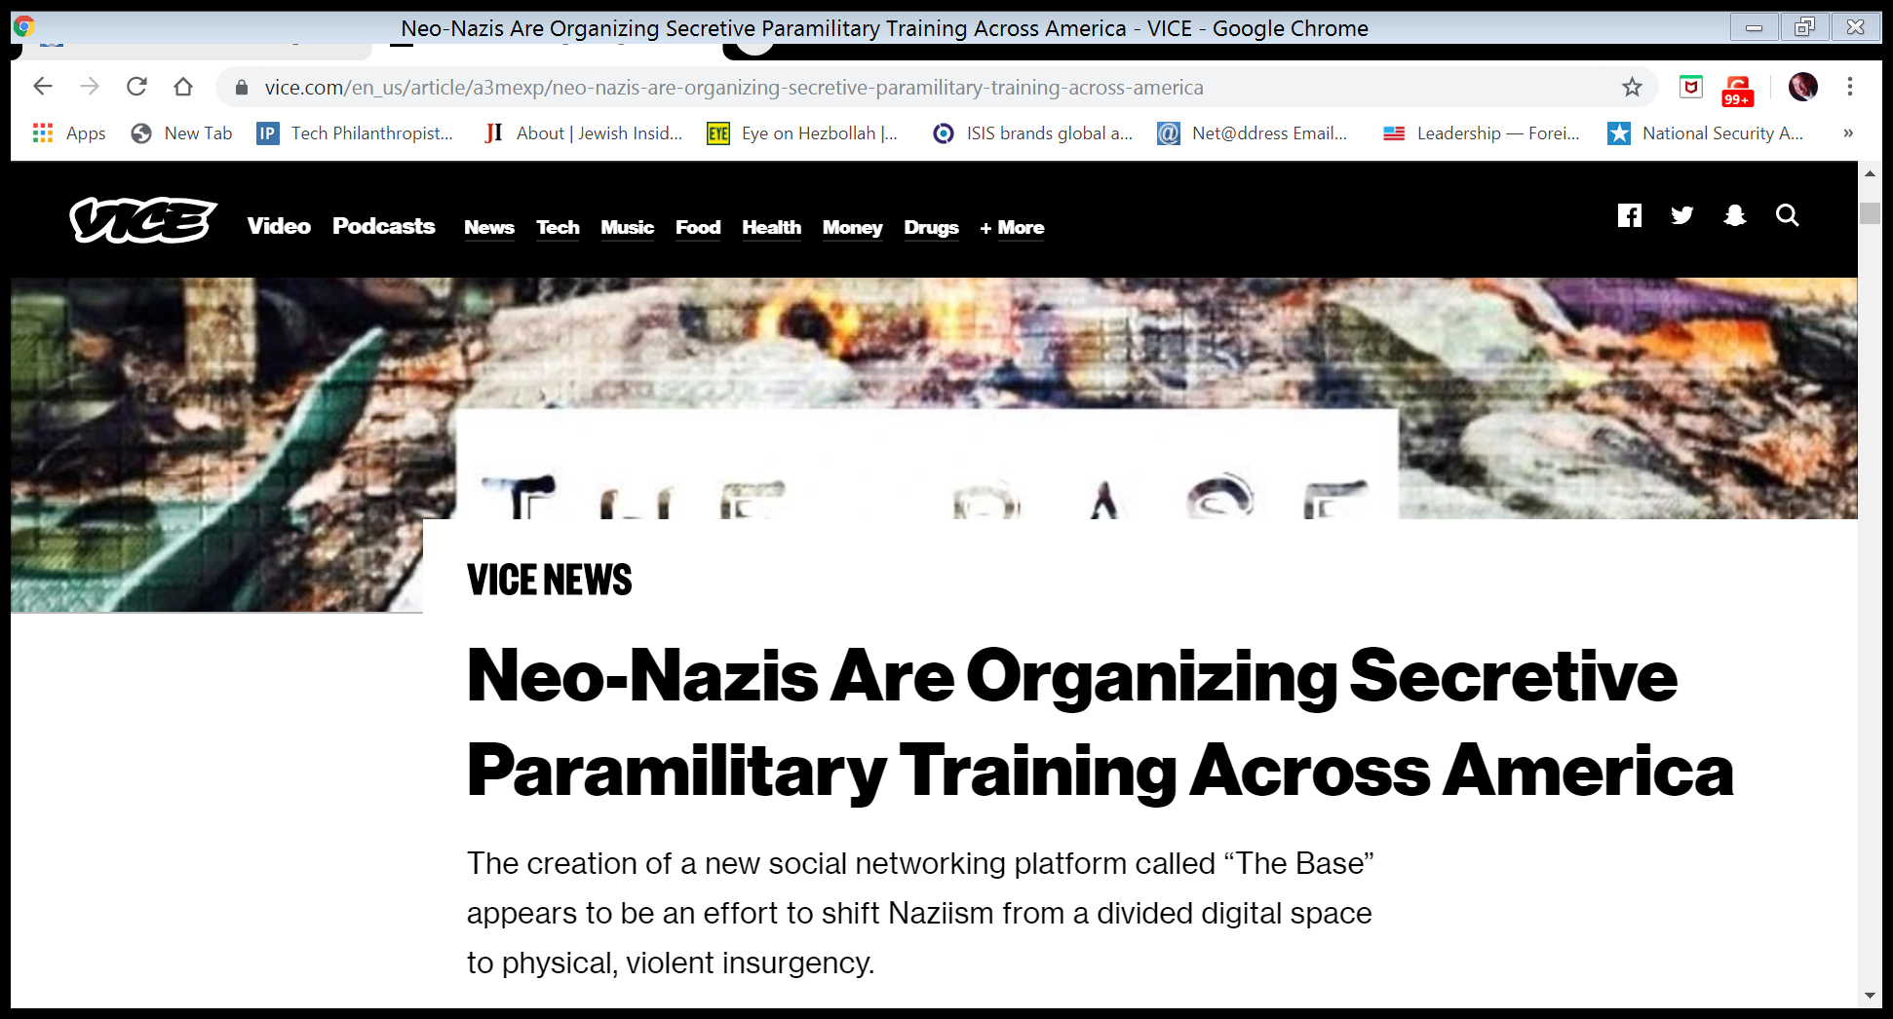

Slide 4
AGENDA
#1 THE RADICALIZATION CONVEYOR BELT OF MAINSTREAM SOCIAL MEDIA PLATFORMS
#2 DANGERS LURKING ON THE DARK WEB & INTERNET INFRASTRUCTURE SUPPORT FIRMS
#3 REGULATION, LEGISLATION, & THE PRIVATE SECTOR
#4 WHAT YOU CAN DO TO EDUCATE AND MOBILIZE CALLS TO ACTION?

Slide 5
SILICON VALLEY HATE CONVEYOR BELT
SECTION 1

Slide 6
COMPLICIT SOCIAL MEDIA COMPANIES
WHY AREN’T SOCIAL MEDIA COMPANIES WILLING/ABLE TO ELIMINATE ON-LINE ANTI-SEMITISM?
* VOLUME CHALLENGES
* VARIANT REAPPEARANCES
* NO FINANCIAL OR LEGAL INCENTIVE (SEC 230)
* REFUSAL TO INTEGRATE NEW TECHNOLOGIES
* DIVISIONS OVER WHAT IS PROTECTED SPEECH
* NO PUBLIC OR PRIVATE ACCOUNTING OF DE- PLATFORMING PLEDGES

Slide 7
ARTIFICIAL INTELLIGENCE THE MYTH
SOCIAL MEDIA CORPORATE ECONOMIC MODELS DO NOT REWARD INNOVATION
AI IS IMPROVING DE-PLATFORMING OF HATE CONTENT, BUT IT IS OVER-HYPED.
HOW? MACHINE LEARNING ALGORITHMS DESIGNED TO PICK UP KEYWORDS AND SYMBOLS”
TECHNO MUMBO JUMBO: API, HASHTAGS, & ENCRYPTION --
AI DOES NOT SPEAK YIDDISH??

Slide 8
HOW DO NEO-NAZIS USE SOCIAL MEDIA?
ATTRACT & LURE VIA ESTABLISHED PLATFORMS
SUPPORTED BY “FREE SPEECH” LIBERTARIANS & ACLU
FACEBOOK IS PRIMARY PORTAL TO ORGANIZE, PROMOTE EVENTS & RECRUIT
* “SONS OF ODIN” HAS 7,000 MEMBERS STILL ON FB
* LEAGUE OF THE SOUTH” WAS BANNED, BUT BACK ON FB
YOUTUBE IS A GOLD MINE OF ANTI-SEMITIC GAMING VIDEOS & “HOW TO KILL” BOMB INSTRUCTIONS

Slide 9
HUNTING HATE THE ANTI-SEMITIC CONTENT
Holocaust Never Happened
Jeffrey Epstein/Harvey Weinstein Jews are Pedophiles and Perverts
Jews are only 2 percent of US population but Jews Control Banks and Media
Impeachment of Trump - Jewish Conspiracy by Jewish Congressman Schiff, Nadler and Lt Colonel Vindman

Slide 10
ENCRYPTION ENABLES HIDING IN PLAIN SIGHT
NEO-NAZIS COMMUNICATE VIA PASSWORD ENCRYPTED PLATFORMS
TELEGRAM, WHATSAPP (CHAT SERVICES)
VICE NEWS ANALYZED 150 PUBLIC FACING FAR-RIGHT TELEGRAM CHANNELS
APP ALLOWS USERS TO UPLOAD UNLIMITED VIDEOS, IMAGES, AUDIO CLIPS & OTHER FILES
RECRUITERS LURE YOUNG MEN IN VIA MEMES, QR CODES, AND ENCRYPTED EMAIL ADDRESSES

Slide 11
THE ANTI-SEMITIC CONTENT “RABBIT HOLE”
GOOGLE SEARCHES LEAD TO OMINOUS CONTENT
TWITTER ACCOUNTS/FACEBOOK ACCOUNTS
MESSAGING BOARDS
ADVERTISE ENCRYPTED EMAIL ADDRESSES & LINK ACCOUNTS BETWEEN PLATFORMS
* POST ON MINDS ACCOUNT LINKED
FEUERKRIEG DIVISION TO GAB & OPENLY DISPLAYED ITS ENCRYPTED “PROTONMAIL” EMAIL ADDRESS

Slide 12
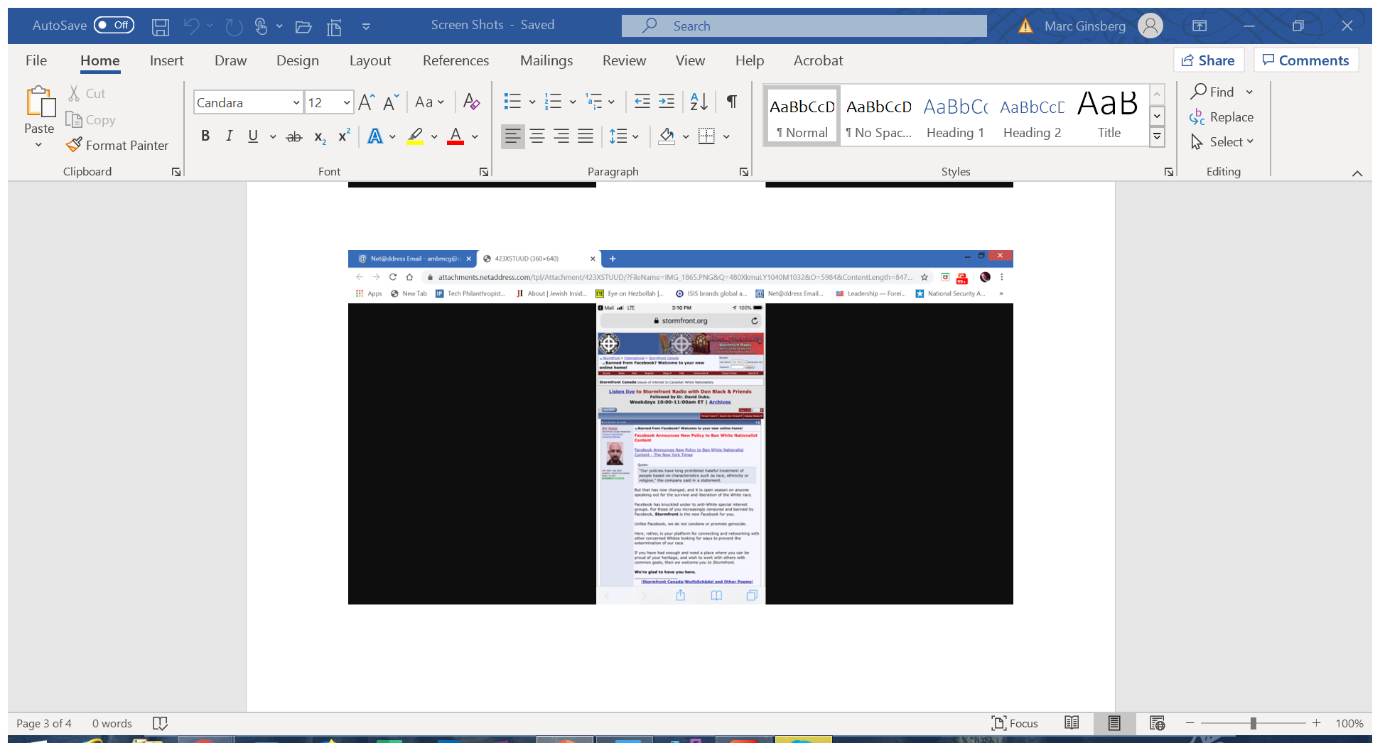

Slide 13
“ZUCK-LIKE” PLEDGES VS. REALITY
MAINSTREAM SOCIAL MEDIA COMPANIES HAVE:
CREATED THE GIFCT (GLOBAL INTERNET FORUM TO COMBAT TERRORISM) – PR STUNT
EXPANDED THEIR PLANS TO COMBAT ONLINE EXTREMISM
HIRED THIRD PARTY “FLAGGERS”
DEPLOYED ARTIFICIAL INTELLIGENCE (AI)
BANNED WHITE NATIONALISM & WHITE SEPARATISM

Slide 14
REALITY
FACEBOOK: VARIANTS OF CHRISTCHURCH MASSACRE UP IN OTHER LANGUAGES
NO UNIFORMITY OF TERMS OF SERVICE OR MEANS OF CORROBORATING SUCCESS
TWITTER: HOSTING ACCOUNTS FOR “THE BASE” – THE MOST DANGEROUS NEO-NAZI INTERNET “ONE STOP SHOP” FOR JEW HATERS
YOUTUBE: EPISODES OF “RADIO WEHRWOLF”
“ZIONIST ORGANIZED GOVTS”
“GOYIM”
“ZOG’S NIGHTMARE

Slide 15
THE “OTHER” OPEN SOURCE NEO-NAZI HIDING SITES
“MINDS” -- A U.S. BASED SOCIAL NETWORK (IT’S MGMT REFUSES TO DE-PLATFORM HATE CONTENT) (FOUNDER BILL OTTMAN)
* ATOMWAFFEN DIVISION
* FEUERKRIEG DIVISION (UNDERGROUND PARAMILITARY GROUP LINKED FROM GERMANY
* PATRIOT FRONT (LINKED TO DEATH OF HEATHER HEYER)
* GENERATION IDENTITY – A GLOBAL HATE GROUP
USE OF TOKEN CRYPTOCURRENCY BY FAR-RIGHT ACCOUNTS TO REWARD CREATORS OR TIPS
550,000 VIEWS EARNED 38 TOKENS FEATURED A JEWISH MAN BEING LYNCHED

Slide 16
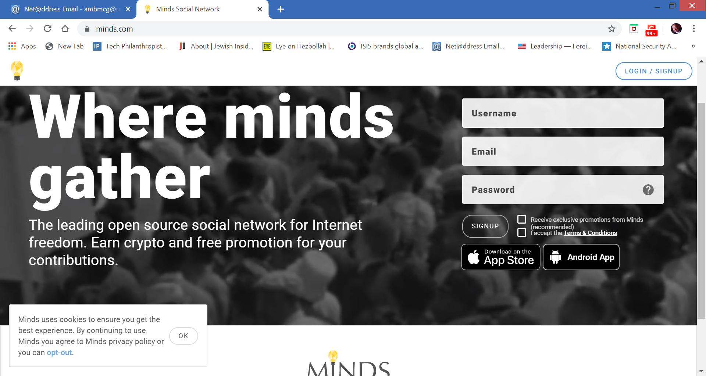

Slide 17
NEO-NAZI WEB HIT LISTS
ANTI-SEMITIC “TROLLS” ARE CREATING A “WEB HIT LIST” OF JEWS WHO ARE “BASE” ENEMIES
THE LIST IS ENCRYPTED ON TELEGRAM (ENCRYPTED MESSAGE EXCHANGE APP)
HAS 2,400 SUBSCRIBERS.
CT SEN. BLUMENTAL ON TOP OF LIST

Slide 18
THE DARK & DEEP WEB “OFF THE GRID”
SECTION 2

Slide 19
WHAT IS THE “DARK WEB” WHAT IS THE “DEEP WEB”
The internet is made up of three different layers: the surface web, the DARK WEB & THE DEEP WEB.
THE DARK WEB
a network of untraceable online activity and websites. They cannot be found using search engines and to access them you need to use specific software, configurations or have passwords. E.g. bank accounts
THE DEEP WEB
Tor is a centralized, encrypted routing network built to keep users anonymous.

Slide 20
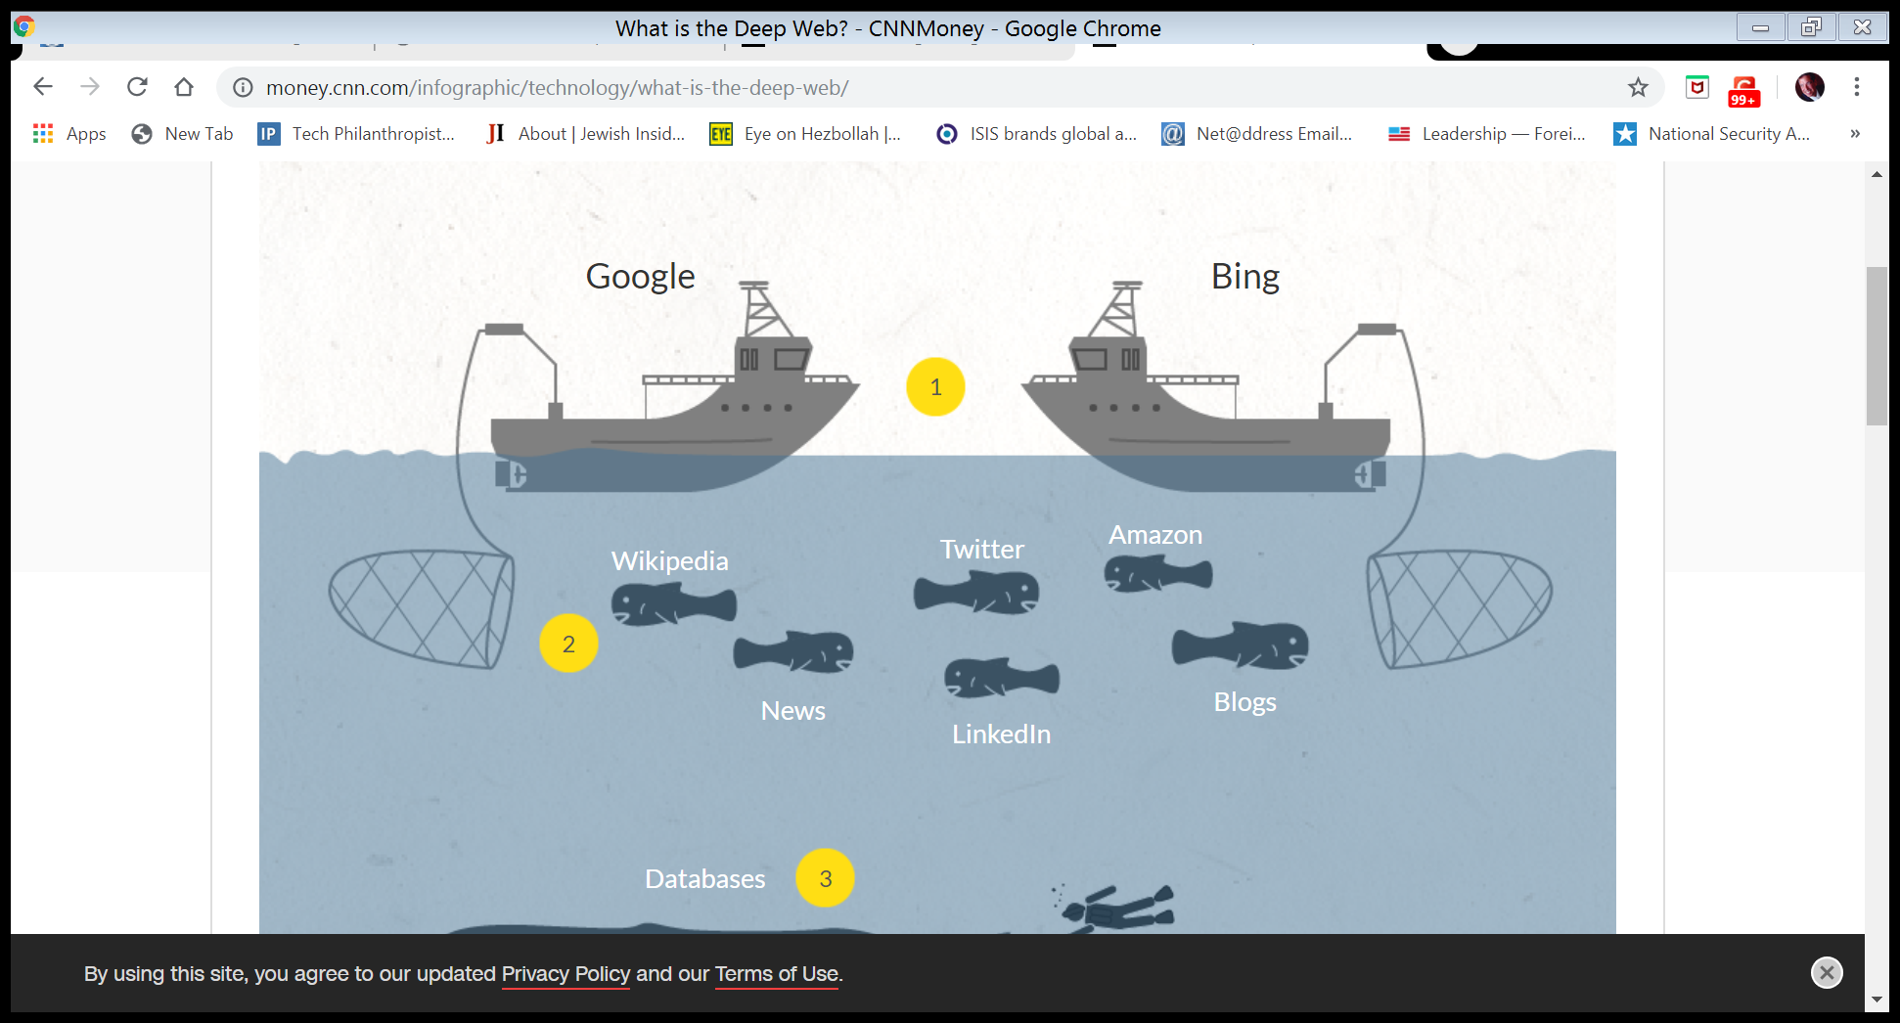

Slide 21
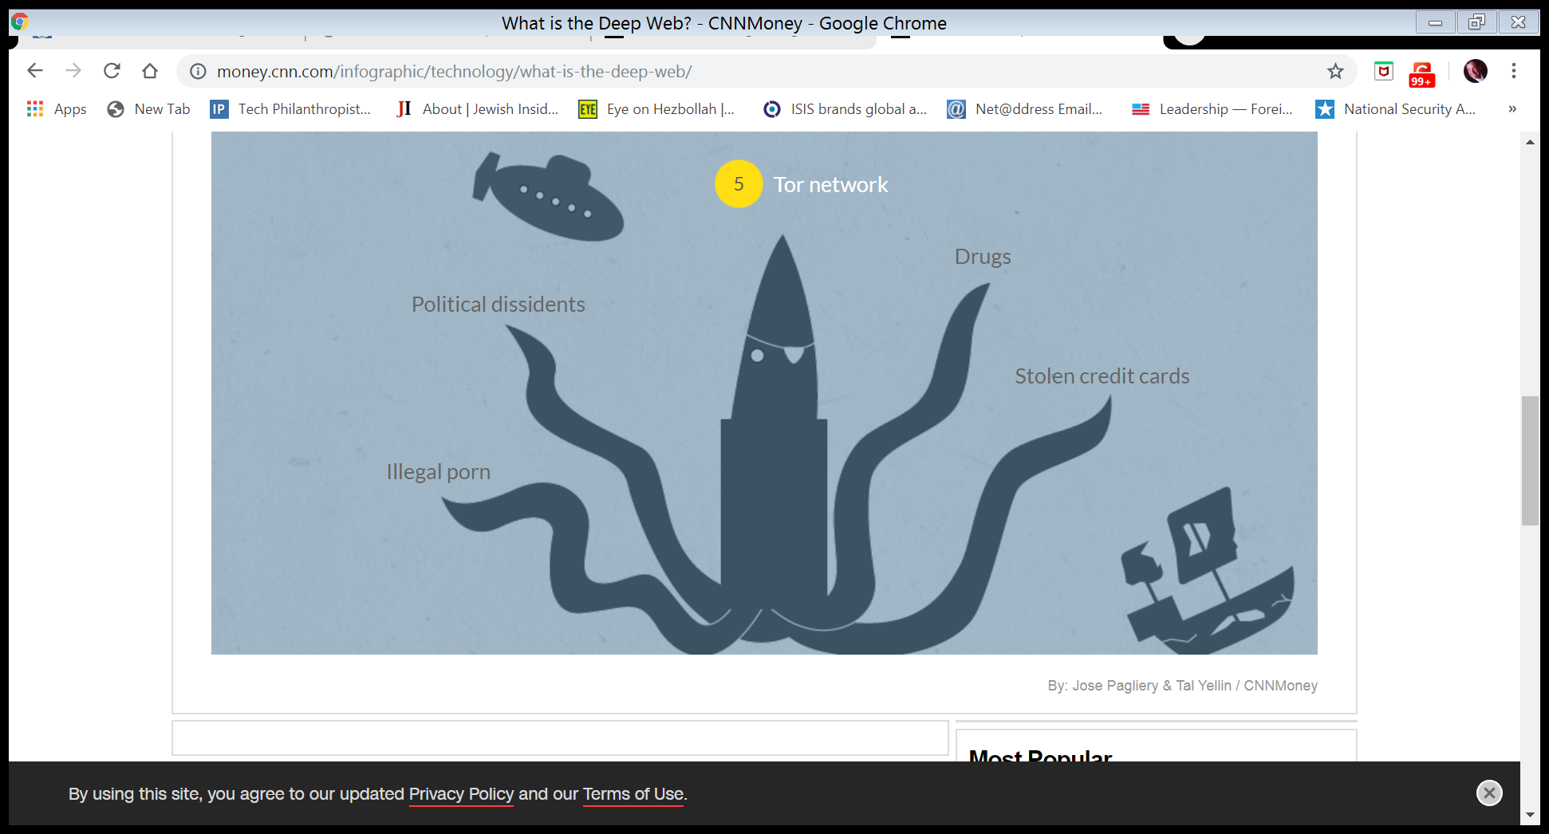

Slide 22
DARK WEB HOSTING COMPANIES
THE DEEP/DARK WEB HOSTING NETWORK PROVIDER SITES MUST BE REGULATED OR SUBJECT TO CONTENT LIABILITY
WITHOUT THEM, ANTI-SEMITIC CHAT ROOMS/COMMUNITIES WOULD NOT BE ABLE TO OPERATE
BLUEHOST
CLOUDFARE – EJECTED DAILY STORMER & GAB
ZENCAST
HOSTINGER INT’L
* (FASCIST FORGE – A FB-LIKE SITE FOR NEO-NAZIS
BITMITIGATE (OWNED BY EPIK “THE SWISS BANK OF DOMAINS) – HOSTS “DAILY STORMER” & GAB
VOXILITY (INFRASTRUCTURE-AS-A-SERVICE PROVIDER

Slide 23
8CHAN
WHAT IS “8CHAN?”
“ANONYMOUS” WEB FORUM & MESSAGING BOARD SERVES AS A GATHERING PLACE FOR ON-LINE NEO-NAZIS
GOAL OF 8CHAN/POL/BOARD IS TO ENGAGE IN “EFFORTPOSTING” (I.E., PROMOTE ACTS OF VIOLENCE).

Slide 24
8CHAN IS BACK
REBRANDED AS “8KUN”
8CHAN WAS USED BY TO ANNOUNCE ATTACKS IN CHRISTCHURCH, PITTSBURGH, POWAY, & EL PASO
POSTING MANIFESTOS TO 8CHAN’S /POL/SUB FORUM
THE ROLE OF THE ACLU DEFENDING 8CHAN

Slide 25
INTERNATIONALIZING WEB CONNECTIONS
FEUERKRIEG DIVISION (FKD) IS A SPLINTER OF
ATOMWAFFEN DIVISION
BORROWING EXTREMIST TACTICS FROM ISIS TO RECRUIT, INCITE, INSPIRE & TRAIN LONE WOLFS
DAILY STORMER NOW USES DARK WEB SERVICES & OVERSEAS HOSTING PROVIDERS TO REMAIN ON LINE

Slide 26
THE “BASE” THE GREATEST DANGER
MEMBERS ACROSS US, CANADA & EUROPE & AUSTRALIA – VIA TWITTER AS INCUBATOR
GOAL: UNIFY ALL OF THE NEO-NAZI CELLS TO FORM AN ANTI-SEMITIC/ANTI-MIGRANT ATTACK COMMAND & CONTROL INTERNET BASE
A RABID ANTI-SEMITIC “ACCELERATIONIST GROUP “
A “ONE STOP MALL” FOR TERRORIST TRAINING, MEET UPS, INCITEMENT, COUNTER-SURVEILLANCE, BOMB MAKING, ETC.

Slide 27
THE BASE IS A MAJOR THREAT TO PUBLIC SAFETY
IT’S LEADERSHIP DETERMINED TO COMMIT TERROR
VICE WAS ABLE TO PENETRATE ITS MAIN CHAT ROOM, WHERE IT IS ACTING JUST LIKE ISIS (CREATING PROPOGANDA & PLANNING “DIRECT ACTION” AGAINST MINORITIES
MATCHMAKING RECRUITS

Slide 28
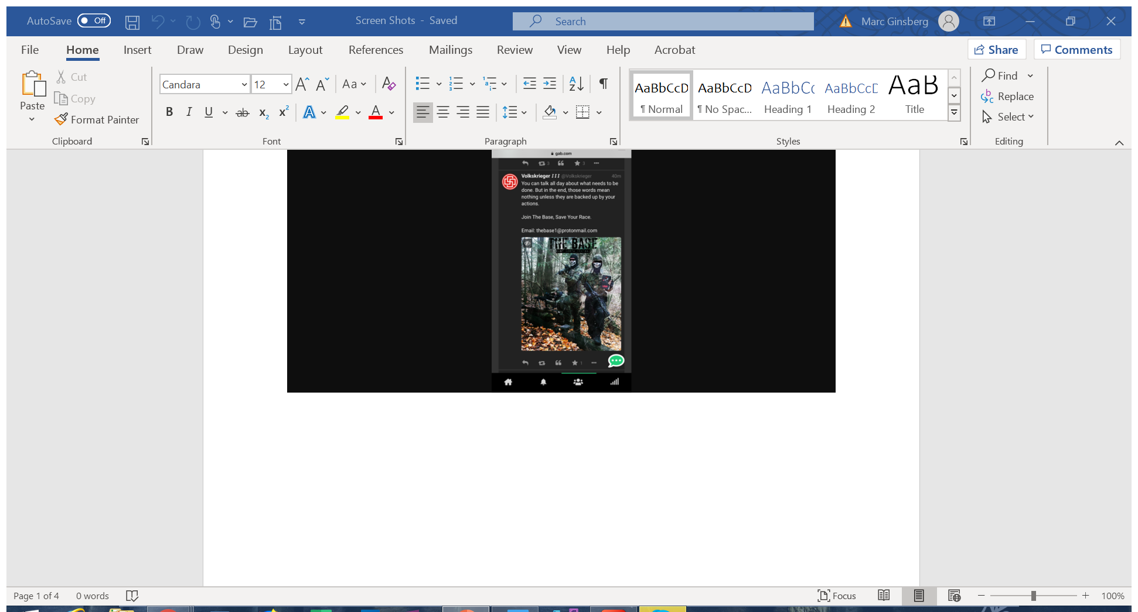

Slide 29
INSIDE THE BASE
RECRUIT SUBMITS AN APPLICATION FORM VIA A “WORDPRESS” SITE
APPLICATION IS VETTED BY “BASE” HR
THOUSANDS OF MEMBERS
IF ACCEPTED, RECRUIT WILL BE INVITED ONTO A CHAT SERVER OPERATED BY RIOT – AN OPEN SOURCE OPERATING SYSTEM USED FOR SECURE MESSAGING

Slide 30
ADMISSION INTO THE BASE
IN THE BASE’S PRIVATE CHAT ROOM, RECRUITS WILL SEE 8 CHANNELS
1. THE “IMPERIUM” MAIN CHAT ROOM
2. SELF DEFENSE
3. BOOKS
4. MUSIC
5. ACTIVITY REPORTS
6. TRAINERS
7. SURVIVALISM
8. A PDF LIBRARY WITH 20 SECTIONS, WITH DOWNLOADABLE MANUALS (GUNSMITHING)

Slide 31
FAR-RIGHT TEEN RADICALIZATION BY “THE BASE”
FAR RIGHT NETWORK ORGANIZED SYNAGOGUE VANDALISM INSTIGATED BY RICHARD TOBIN, AGE 18 OF NJ
“THE GREAT LAKES CELL”
“OPERATION KRISTALLNACHT”
NEXT DAY, TEMPLES IN HANCOCK, MI, RACINE WI WERE DEFACED, & INSIGNIA OF “THE BASE”

Slide 32
NEO NAZIS ARE RECRUITING GENERATION Z
GEN-Z MEME WEB SITE USED BY “THE BASE”
IFUNNY NOW HAS A PROPAGANDA VIDEO SHOWING THE BASE TRAINING IN US
VIDEO GAMING
SALE OF ILLICIT DRUGS & STEROIDS TO FUND NEO-NAZI OPERATIONS

Slide 33
REGULATION, LEGISLATION & THE PRIVATE SECTOR
Section 3

Slide 34
THE ROLE OF CONGRESS
A CLIFF NOTES GUIDE TO SECTION 230 OF THE COMMUNICATIONS DECENCY ACT OF 1996
GROWING OUTCRY, BUT NO LEGISLATIVE SUCCESS
CONGRESS MUST REGULATE B2B TECH FIRMS, SUCH AS CLOUD INFRASTRUCTURE PROVIDERS
THE CHALLENGE POSED BY ENCRYPTION (WHATSAPP, TELEGRAM, ETC.) – PRIVACY LAWS
THE NEED FOR A DOMESTIC TERRORISM LAW

Slide 35
THE EXECUTIVE BRANCH
NO TANGIBLE ACTION FROM THE TRUMP WHITE HOUSE
WHITE HOUSE HAS SUPPORTED CODIFYING SECTION 230 IN TRADE DEALS
THE FBI & DHS HAVE ACCELERATED PENETRATION OF WHITE NATIONALIST GROUPS

Slide 36
THE ROLE OF THE PRIVATE SECTOR
ANTI-DEFAMATION LEAGUE/SOUTHERN POVERTY LAW CENTER
THE DIGITAL ADVERTISING ECOSYSTEM & GARM (GLOBAL ALLIANCE FOR RESPONSIBLE MEDIA)
ADVERTISING BOYCOTTS OF ALPHABET & FB COME & GO
CORPORATE AMERICA…IBM, PFIZER, ETC.
A CALL TO ACTION TO REGULATE THE DARK WEB WEB SERVICE PROVIDERS

Slide 37
WHAT CAN YOU DO?
CALLS TO ACTION
MOBILIZING YOUR CONGREGATION
SECTION 4

Slide 38
THE JEWISH COMMUNITY IS NOT/NOT PRO-ACTIVE
WHERE IS THE ANTI-WHITE NATIONALIST EDUCATION PROGRAM IN SCHOOLS?
WHERE IS THE CIVIC COALITION TO PUSH FOR CHANGES TO SECTION 230
WHEN WILL CONSUMERS DEMAND MORE ACCOUNTABILITY FROM DIGITAL ADVERTISERS

Slide 39
AN AGENDA FOR ACTION
WEBINARS/EDUCATION FOR CONGREGATIONS – AN ANTI-EXTREMIST EDUCATION MANUAL FOR STUDENTS
A CALL TO ACTION TO DEMAND REGULATION OF DARK WEB OPERATIONS
AN END TO SECTION 230 CONTENT IMMUNITY
A CALL TO ACTION TO DEMAND MORE ACCOUNTABILITY FROM YOUTUBE, FACEBOOK, INSTAGRAM. -- THE CONSUMER ANGLE
SHAREHOLDER ACTIONS IN ANNUAL CORPORATE MEETINGS
PENALTIES FOR ENCRYPTION COMPANIES WHICH DO NOT COOPERATE WITH THE FBI

Slide 40
AMB. MARC GINSBERG
AMBMCG@USA.NET
WWW.COALITIONSW.ORG
202-352-1995

